Slide 2

Learning objectives
In this lesson students will learn to:
  Explain that the 'range' function generates a sequence of numbers
  Use the iteration 'for' to process every item in a one-dimensional data structure.
For more information on this topic, and additional student activities, see Topic 1.6 of the student book.
© Pearson Education Ltd 2020. Copying permitted for purchasing institution only.
Notes:
Specification content: 1.2.1 1.2.2 6.1.3 6.2.2 6.3.1

Slide 3
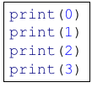
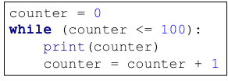
Generating numbers
How might you go about printing all the numbers from 0 to 100?
You could simply print them all one at a time in a sequence.
You could use a while loop and a counter.
But there is a more efficient way to do it.
© Pearson Education Ltd 2020. Copying permitted for purchasing institution only.

Slide 4
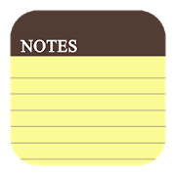
The range function
You can use the Python function range().
Range is a built-in Python function that generates a sequence of integers.
Range is most commonly used in for loops which you will look at shortly.
First you need to understand how to use range and what it returns.
© Pearson Education Ltd 2020. Copying permitted for purchasing institution only.
Notes:
More details about the range function can be found here: https://docs.python.org/3/library/stdtypes.html?highlight=range#range

Slide 5
Usage
If you create a variable and assign a range to it, it looks like this:
However, if you print ‘nums’, you get:
To be able to see deeper inside, you need to convert the result to a list.
nums = range(10)
range(0, 10)
nums = list(range(10))
[0, 1, 2, 3, 4, 5, 6, 7, 8, 9]
Notice: it starts at 0 and counts ten digits
© Pearson Education Ltd 2020. Copying permitted for purchasing institution only.

Slide 6
Usage parameters
When using range there are three values that you can enter into the brackets.
These are called parameters.
Some of these are optional, which means you can leave them out. Python will then use default values.
range(start, stop, step)
start - The starting point or first digit (default: 0).
stop - The number of numbers to generate (final value + 1).
step - The number to add each time, e.g. 2 would be every other number (default: 1).
© Pearson Education Ltd 2020. Copying permitted for purchasing institution only.
Notes:
Student Activity 1

Slide 7
Making range useful
The most common use of range is in a for loop.
You learned previously about generating repetition using while loops.
You saw that such a condition-controlled loop can be used to repeat blocks of code while a condition is true.
You can use for and range together to produce a different type of loop that runs a precise number of times – a for loop.
This kind of loop is known as a count-controlled loop.
© Pearson Education Ltd 2020. Copying permitted for purchasing institution only.

Slide 8
For loops
You need a program that can count from 1 to 100 and output that value.
Using a for loop it would look like this:
You may see the letters ‘i’, ‘j’, or ‘k’ used in a for loop. Experienced programmers tend to use one-letter identifiers for variables in situations where the variable will not be used again.
However, you should use an identifier that has meaning in the context of your code, as this will make your code more readable and your logic clear.
Start at 1 and go up to 100. Remember that the stop is the number after the one you really want.
for num in range(1, 101):
print(num)
© Pearson Education Ltd 2020. Copying permitted for purchasing institution only.
Notes:
Student Activity 2

Slide 9
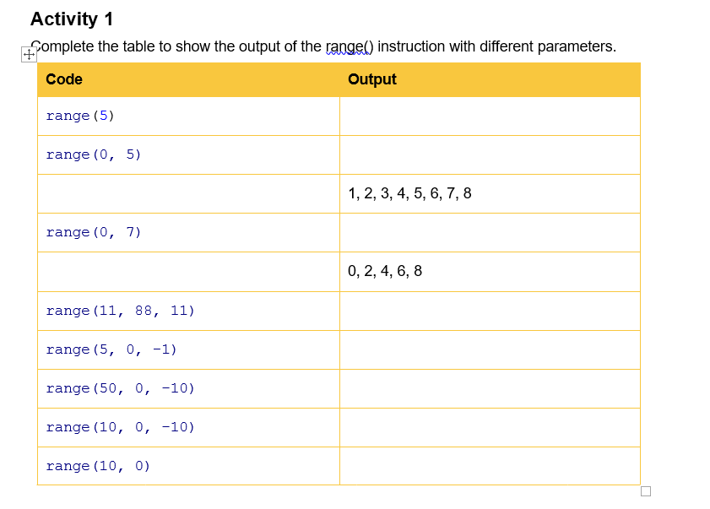

Have a go at Activity 1
© Pearson Education Ltd 2020. Copying permitted for purchasing institution only.

Slide 10
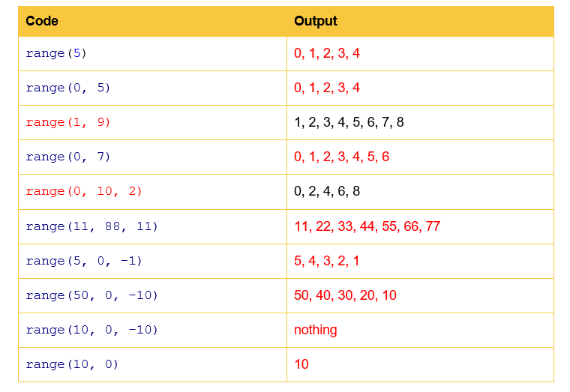
© Pearson Education Ltd 2020. Copying permitted for purchasing institution only.

Slide 11
For loops and lists
You can use a for loop to iterate over a list.
This means that you can look at or perform an operation on each item in that list one at a time.
This is incredibly useful and is a very commonly used technique in all programming languages.
Let’s see how it is done.
© Pearson Education Ltd 2020. Copying permitted for purchasing institution only.

Slide 12
For loop and list example
You have a list of items. You want to print every item in the list, in sequence.
You can iterate over the list and print each item in turn like so:
Notice that ‘item’ has been used instead of ‘I’ for the iterator variable.
What will happen when this program is run?
colours = ["red", "blue", "green", "yellow", "blue", "black", "orange"]
for item in colours:
print(item)
© Pearson Education Ltd 2020. Copying permitted for purchasing institution only.

Slide 13
Example output
red
blue
green
yellow
blue
black
orange
Is this what you expected?
© Pearson Education Ltd 2020. Copying permitted for purchasing institution only.

Slide 14
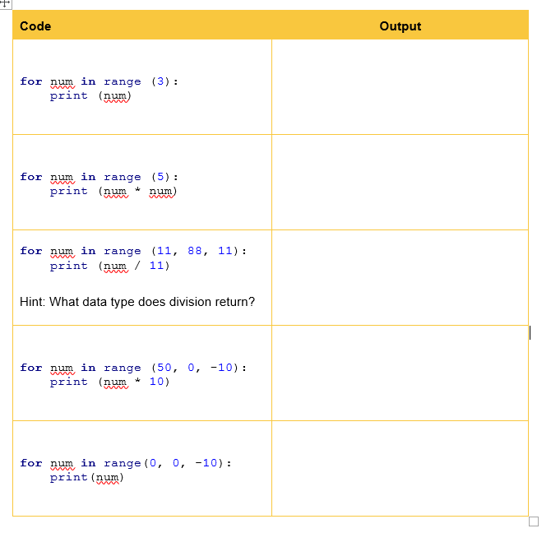
Activity 2
© Pearson Education Ltd 2020. Copying permitted for purchasing institution only.

Slide 15
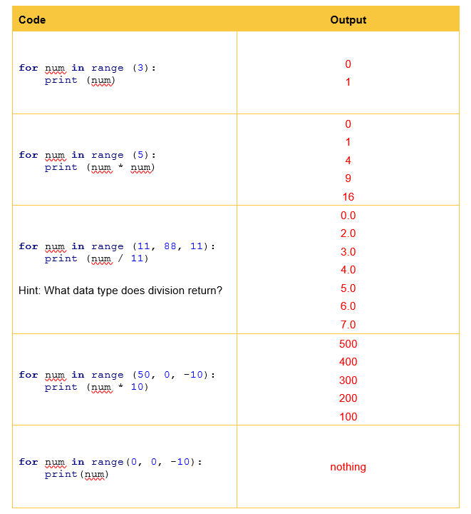
© Pearson Education Ltd 2020. Copying permitted for purchasing institution only.

Slide 16
For loops and flowcharts
You saw before that there is no ‘while loop’ symbol in a flowchart.
What did you have to use instead?
You used a decision and a path that looped back.
There’s no ‘for loop’ symbol in flowcharts, either.
What do you think is used instead?
Let’s look at an example that shows the algorithm for printing colours stored in a list.
© Pearson Education Ltd 2020. Copying permitted for purchasing institution only.

Slide 17
Flowchart
This is the flowchart that performs the same action as the Python code you’ve just seen.
You can see the arrow looping back to the decision. This represents the iteration.
Once the end of the list is reached, the program ends.
Any number of instructions can be performed inside the loop.
The number of loops is exactly the same as the length of the input list.
start
initialise list of colours
is list finished?
Yes
No
print current element
stop
© Pearson Education Ltd 2020. Copying permitted for purchasing institution only.
Notes:
Student Activities 3, 4 and 5

Slide 18
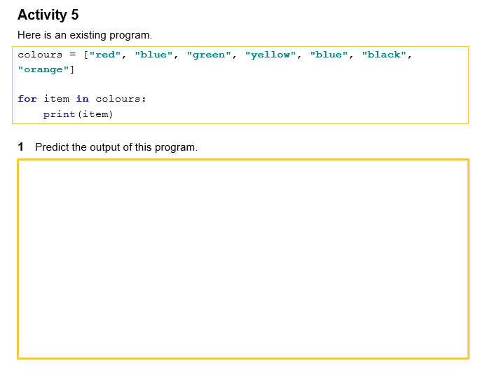
Practical task – complete all of task 5
© Pearson Education Ltd 2020. Copying permitted for purchasing institution only.

Slide 19
Wrap up: you have learned how to…
Explain that the 'range' function generates a sequence of numbers.
  Range generates a series of integers from start to stop.
  It can include a step to ‘skip’ numbers out.
Use the iteration 'for' to process every item in a one-dimensional data structure.
  For loops are count controlled.
  Used with ‘range’ ‘for’ produces a loop that runs a specific number of times.
  You can also use ‘for’ to loop through an array.
© Pearson Education Ltd 2020. Copying permitted for purchasing institution only.

